Slide 1
Human Activity Recognition Using Accelerometer and Gyroscope Data
Prepared by: Ahmad Abdel-Qader

Slide 2
Dataset:
Source: Kaggle https://www.kaggle.com/malekzadeh/human-activity-recognition-with-mobile-sensing
https://archive.ics.uci.edu/ml/datasets/human+activity+recognition+using+smartphones
Each person performed six activities (10299 rows):
Walking
Walking upstairs
Walking downstairs
Sitting
Standing
Laying
The dataset was split into training (70%) and testing (30%)

Slide 3
Loading Data:
Observations were recorded at 50 Hz frequency
Each series of data was windowed into 2.56 seconds, which equals to 128-time step (50 * 2.56).
Features used for training the machine learning models are:
3-axis accelerometer data
3-axis gyroscope data
3-axis body-acceleration (removing gravity with 0.3 Hz high-pass filter)

Slide 4
Recurrent Neural Network(RNN):
A Recurrent Neural Network (RNN) is a type of neural network well-suited to time series data.
RNNs process a time series step-by-step, maintaining an internal state summarizing the information they've seen so far.
A specialized RNN layer called Long Short-Term Memory (LSTM) was used in our model.

Slide 5
Model Definition:
The model was defined using the Tensorflow library.
Data were input to the RNN network as a time series data 128 step time (2.56 s window)
Each row of data (sample) contains 128 reading has a unique label
Total number of elements to the RNN = 128-time steps * 9 features = 1152
The model required three dimensions input (samples, time steps, features)

Slide 6
Model Definition

Slide 7
Resulting Accuracy:
After training the model, test data were used to calculate the accuracy.
Training set accuracy: 92.7%
As a result, the test accuracy is: 90.34 ± 1.07%
The model was trained for 12 different times. The overall accuracy figure is the average of each training accuracy. The error is the standard deviation of the training accuracy values.

Slide 8
Feature work – Ways to improve RNN classification accuracy:
We use the raw data from accelerometer and gyro to train the model. Using engineered features (such as: signal entropy, correlation coefficient, median absolute deviation between two signals) can enhance the accuracy of the model.
The neural networks we used are preliminary. Multiple refinements can be made using hyperparameter tuning. The test accuracy is expected to improve above 90% after optimizing the network via hyperparameter tuning.
Convert the final model to be compatible with mobile phones.

Slide 9
Support Vector Machine(SVM):
The input data now is 2-D rather than 3-D in RNN
Input data are [samples, timesteps * features]
[10299 samples, 128 timesteps * 9 features]
Total accuracy from test data is: 89.1%

Slide 10
Convolutional, Long Short-Term Memory(CNN – LSTM):
The CNN LSTM architecture involves using Convolutional Neural Network (CNN) layers for feature extraction on input data combined with LSTMs to support sequence prediction.
128 time steps were split into 32 time steps subsequences for CNN model to process.
TimeDistributed layer used to allow same CNN model to read the four subsequences in the window.
The resulting training accuracy is: 96.95%
The resulting test accuracy is: 90.14 ± 1.10 %
Source: Network structure is used from T. N. Sainath, O. Vinyals, A. Senior and H. Sak, "Convolutional, Long Short-Term Memory, fully connected Deep Neural Networks," 2015 IEEE International Conference on Acoustics, Speech and Signal Processing (ICASSP), Brisbane, QLD, 2015, pp. 4580-4584. doi: 10.1109/ICASSP.2015.7178838

Slide 11
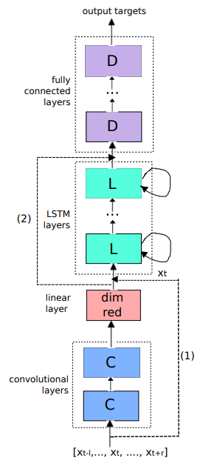
Convolutional, Long Short-Term Memory (CNN – LSTM) structure:
T. N. Sainath, O. Vinyals, A. Senior and H. Sak, "Convolutional, Long Short-Term Memory, fully connected Deep Neural Networks," 2015 IEEE International Conference on Acoustics, Speech and Signal Processing (ICASSP), Brisbane, QLD, 2015, pp. 4580-4584. doi: 10.1109/ICASSP.2015.7178838

Slide 12
Comparison of the models:
 | RNN (LSTM) | SVM | CNN-LSTM
Training accuracy (%) | 92.7 |  | 96.95
Test accuracy (%) | 90.34 ± 1.07 | 89.1 | 90.14 ± 1.10
RNN (LSTM) has the highest test accuracy.
The difference between training and test accuracies correlate with overfitting. Since RNN (LSTM) model has lower accuracy lag with respect to CNN-LSTM, it is going to have lower overfitting with larger datasets.
Higher test accuracy with smaller network size with RNN (LSTM) than CNN-LSTM shows networks size/complexity does not necessarily mean higher test accuracy.
RNN (LSTM) is the most appropriate model.
For mobile devices, we are going convert the 32-bit model to 8-bit models (Tensorflow Lite).

